Slide 1
Using Trifolia-on-FHIR to Profile and Create FHIR Implementation Guides
Sarah Gaunt
11/09/2019

Slide 2

Who am I?
Name: Sarah Gaunt
Company: Lantana Consulting Group
Background:
Data Analyst
Oracle/SQL Server Programmer
CDA IG Specialist
FHIR IG Almost-specialist
sarah.gaunt@lantanagroup.com

Slide 3
This presentation
Can be downloaded here:
https://github.com/FHIR/documents/blob/master/presentations/2019-09 IG Training/Using Trifolia-on-FHIR to Profile and Create FHIR IGs - Sarah.pptx
Is licensed for use under the Creative Commons, specifically:
Creative Commons Attribution 3.0 Unported License
(Do with it as you wish, so long as you give credit)

Slide 4
Agenda
Creating a FHIR IG (Quick overview)
Trifolia-on-FHIR
Overview of tool
Main Functions
Creating and editing an ImplementationGuide
Creating and editing Profiles (StructureDefinition)
Creating and editing Terminology
Importing files
Publishing
Exporting

Slide 5
Creating a FHIR IG (Quick overview)
Define resources needed for an IG
Implementation Guide
Use Case Profiles (StructureDefinition)
Terminology (ValueSet, CodeSystem)
Conformance statements etc.
Develop the structure of the IG
Page Structure
Narrative guidance
Run the IG Publisher to publish the IG
Results in a set of HTML pages that can be posted to a web server

Slide 6
Trifolia-on-FHR: Overview of Tool
Trifolia-on-FHIR
Web-based tool
Back end is FHIR servers (HAPI)
Supports multiple servers and version of FHIR
Integrated with the HL7 FHIR IG Publisher

Slide 7
Trifolia-on-FHIR: Main Functions
Create and edit an ImplementationGuide
Create and edit profiles and extensions (StructureDefinition)
Add resources to an ImplementationGuide
Create and edit the pages and narrative content of an IG
Publish the IG (using the HL7 IG Publisher)
Run the FHIR IG Publisher right in ToF
View the resulting IG
QA and validate
Export all files needed to publish the IG elsewhere (like the FHIR CI build)

Slide 8
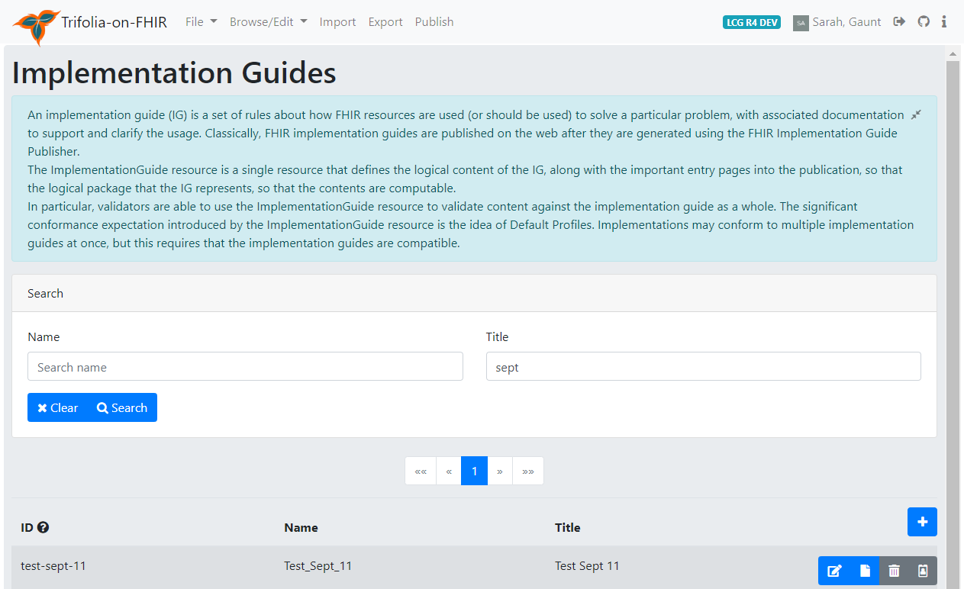
Browse Implementation Guides
Search for an IG by name or title
Edit IG
View published IG
Delete IG
Change ID
Add/create new IG
1
6
1
3
4
5

Slide 9
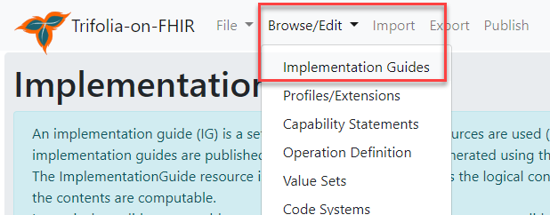
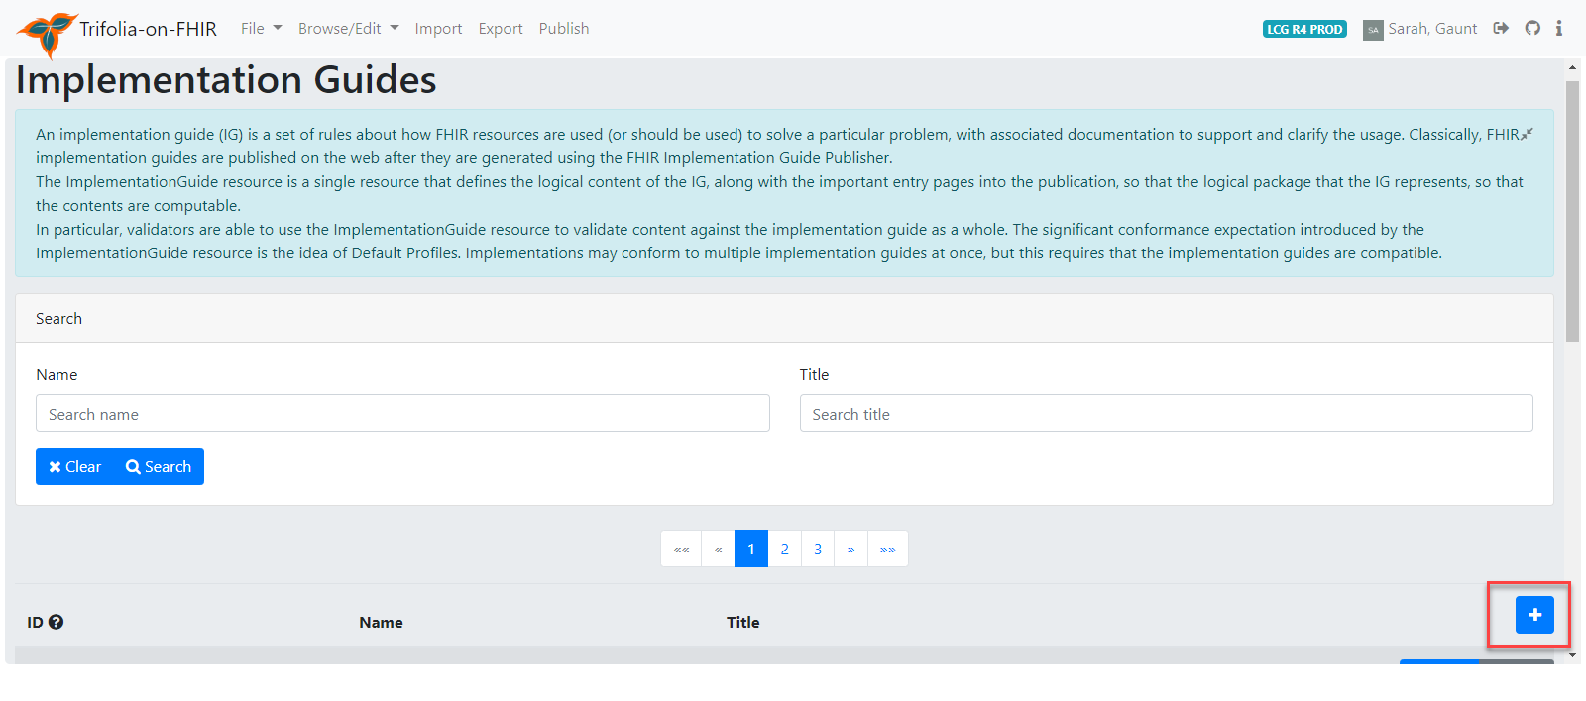
Creating an Implementation Guide
Browse/Edit Implementation Guides
Click on + icon

Slide 10
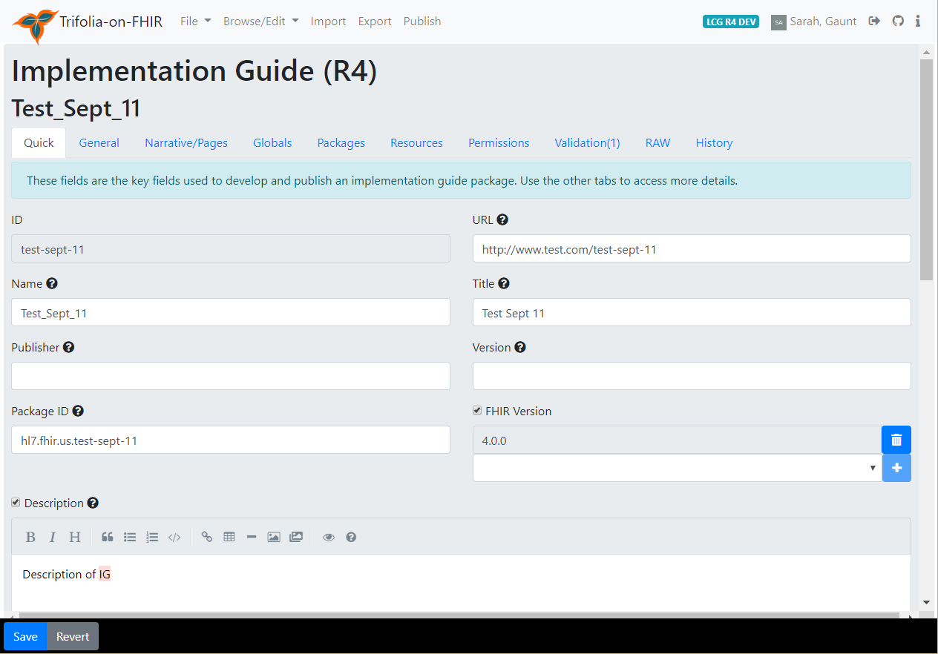
Creating an Implementation Guide
Browse/Edit Implementation Guides
Click on + icon
On Quick tab
Add the IG canonical url
Add the IG name
Add the package ID
Set the FHIR version (click +)
Add description
Add dependencies
Add more metadata on the General tab
SAVE

Slide 11
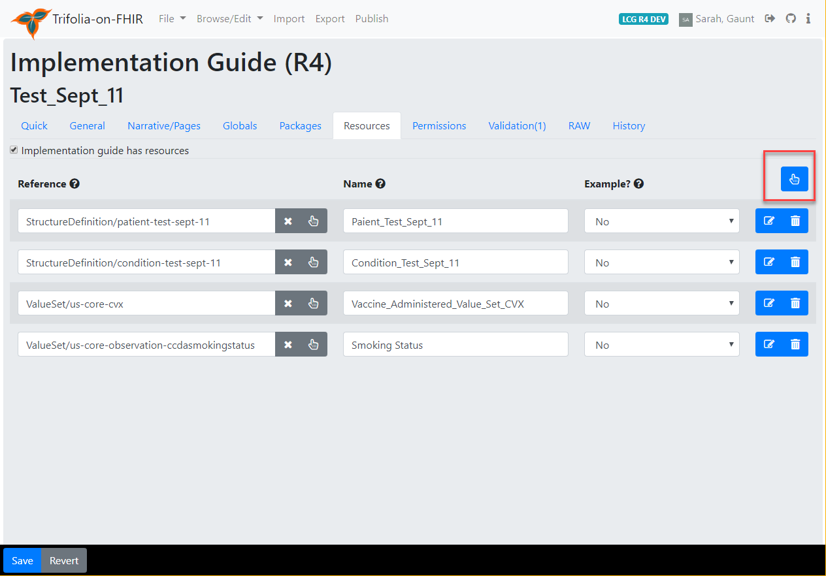
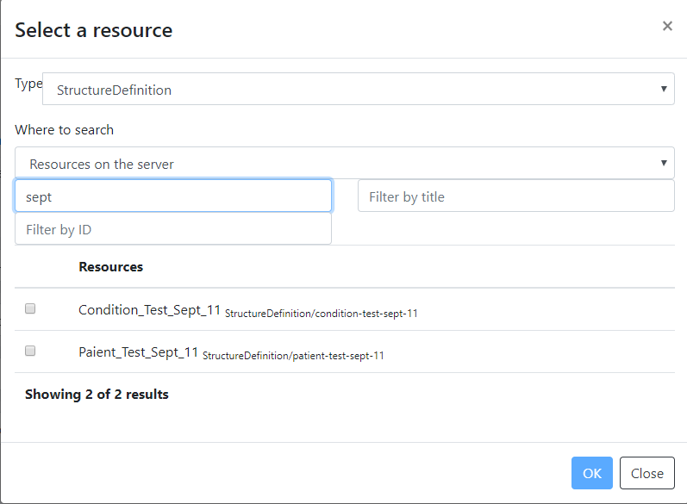
Adding IG Resources

Slide 12
Additional Actions
Adding pages
Creating and editing profiles
Creating and editing terminology
Importing files
Publishing/Exporting

Slide 13
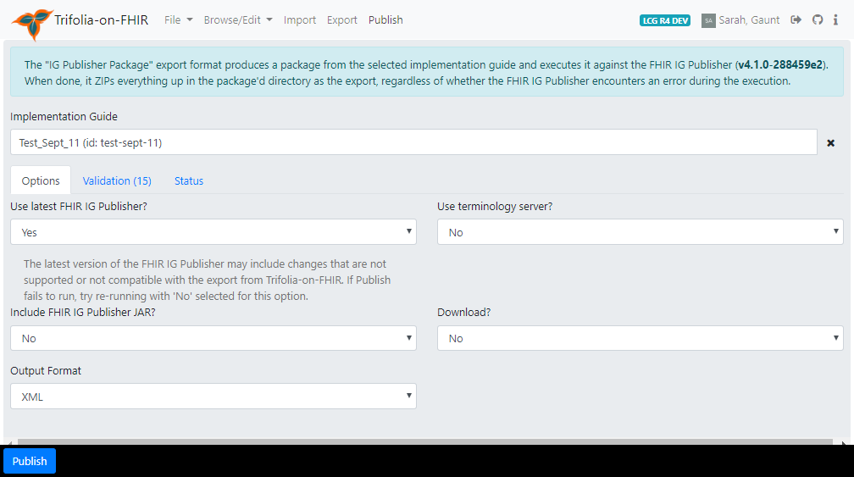
Publish IG
Select IG
Use most recent IG Publisher
Use terminology server
Include IG Publisher JAR in download (if downloading)
Download IG (for local/CI build)
Output of download (JSON or XML)
1
2
3
4
5
6

Slide 14
Live Demo

